Slide 1
Sprite Animation
Introduction to Game Design and Development
ITCS 4230/5230
Dr. Dewan Tanvir Ahmed
Department of Computer Science
University of North Carolina at Charlotte

Slide 2
Do a barrel roll! – Star Fox
Do you think I'm trying to trick you with reverse psychology? I mean, seriously, now. - Portal (game)
Opps, sorry. I must have knocked on the door a bit to hard. - Devil May Cry

Slide 3
2D Animation - Traditional
AKA Cel or Hand-drawn Animation - where each frame is drawn by hand
Like Flip Books
Images sequence, each differing slightly, to show movement
http://www.youtube.com/watch?v=FH97UerMW6I
Essentially, this is what we use in XNA
The technique was the dominant form of animation in cinema until the advent of computer animation.

Slide 4
Other Techniques
Puppet Animation
Claymation [Youtube - example
3D Animated Models turned into Sprites
Rotoscoping
animators trace live-action movement, frame by frame
Youtube: rotoscope animation
Cutout Animation
stop-motion animation produced by moving 2-dimensional pieces of material such as paper, card, stiff fabric or even photographs or cloth

Slide 5
2D Animation – Video Games
Creation of moving pictures in 2D, such as cel animation or in computerized animation software
Sequencing consecutive images, or "frames“
simulate motion by each image showing next in a gradual progression of steps
24 FPS needed to fool the eye into seeing motion

Slide 6
Key Terminology
Frame – single rendered/recorded image
FPS – frames per second
Frame Length – length, in pixels, of frame
Offsets – used to denote that frame is not at (0,0)

Slide 7
Key Terminology
Sprite – 2D image/animation
Sprite Rips - taking sprites from a video game using emulators and ROMs
Spriter – someone who makes sprites
Sprite Sheets – 2D animation series – instead of multiple images, all animations are on one image – saves space

Slide 8
Definition
What is a sprite animation really?
a series of 2D images that makeup an animated character

Slide 9
Sprites are Used for?
Main character
Enemies
Any living thing
Projectiles (rockets, bullets, arrows, rocks, etc.)
Vehicles

Slide 10
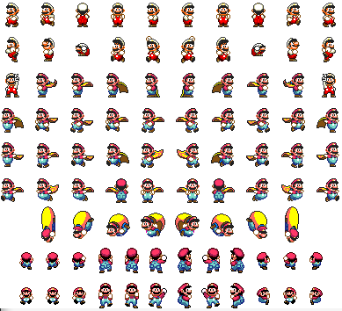
Sprite Sheets

Slide 11
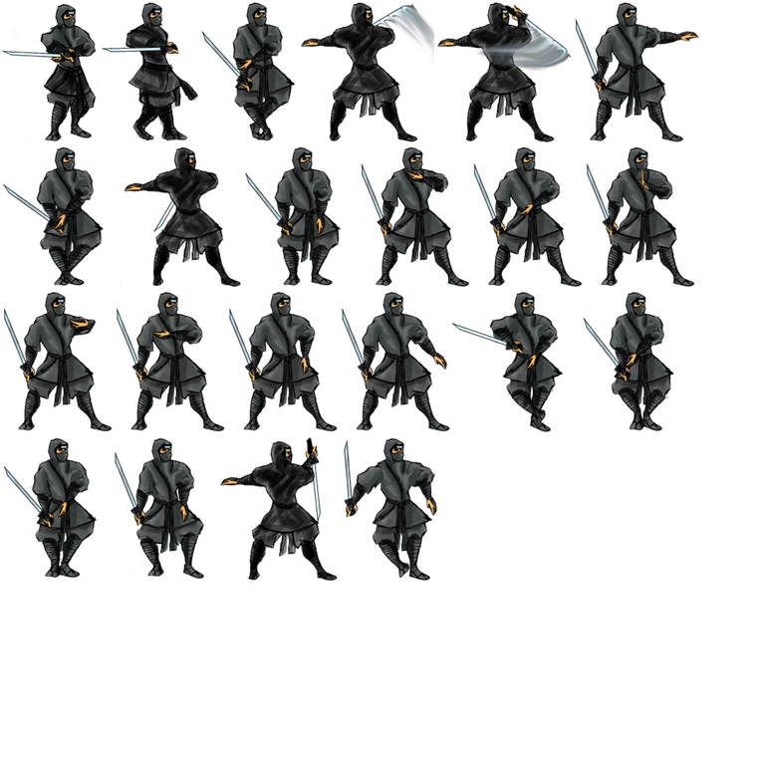
Sprite Sheets

Slide 12
Animating Sprites
As a sprite moves, display using different “frames of animation”
this means slightly different images
Works just like traditional cartoon animation
Animation must be:
tied to timer
tied to movement (for main character)

Slide 13
What Sort of Sprite Data?
Position
Z-order
Velocity
Texture(s)
Array of Textures if using individual images
Each index represents a frame of animation
Possible states of sprite
Current state of sprite (standing, running, jumping, etc.)
Animation sequences for different states
Current frame being displayed (an index)
Animation speed

Slide 14



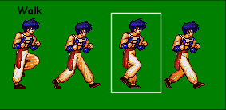

Animation Frame
X coordinate of the upper left corner of the frame
Y coordinate of the upper left corner of the frame
Width of frame
Height of frame
5 248
56 251
139 248
196 251
37 89
61 86
37 88
82 86

Slide 15
Rules of Thumb
Transparency is better
Use png file formats
Good animation requires at least 3 frames
Calculation required
Harder to handle moving up and down frames if not mathematical
Label everything to avoid confusion

Slide 16
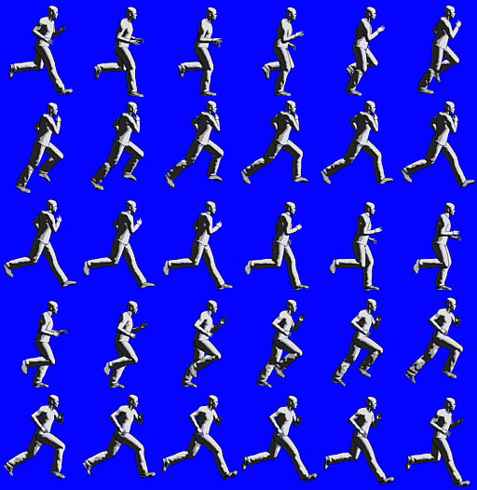
Animation
Animations are made up of a number of standalone images, and flipping through the images in a cycle causes them to appear animated

Slide 17
Background Info
Resolution
512 x 526
sheetSize (6, 5)
frameSize(512/6, 526/5)
Framesize
(85, 105)

Slide 18
Animated Sprites
Create a Project
Load an sprite Sheet.
Initialize processing variables:
Point frameSize = new Point(85, 105);
Point currentFrame = new Point(0, 0);
Point sheetSize = new Point(6, 5);

Slide 19
Add code to Draw Method
spriteBatch.Begin(SpriteSortMode.FrontToBack, BlendState.AlphaBlend);
spriteBatch.Draw(
texture, Vector2.Zero,
new Rectangle(currentFrame.X * frameSize.X,
currentFrame.Y * frameSize.Y,
frameSize.X,
frameSize.Y),
Color.White, 0, Vector2.Zero, 1, SpriteEffects.None, 0);
spriteBatch.End();

Slide 20
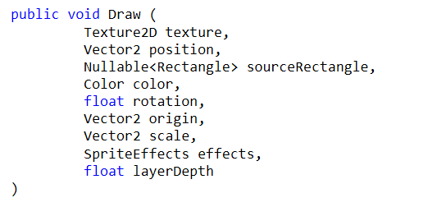
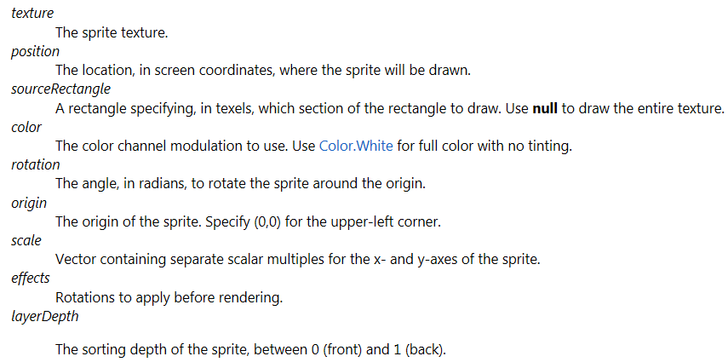
Sprite Draw

Slide 21
Add Class-level variable
int timeSinceLastFrame = 0;
int millisecondsPerFrame = 20;

Slide 22
Modify Update method
timeSinceLastFrame += gameTime.ElapsedGameTime.Milliseconds;
if (timeSinceLastFrame > millisecondsPerFrame) {
timeSinceLastFrame -= millisecondsPerFrame;
++currentFrame.X;
if (currentFrame.X >= sheetSize.X) {
currentFrame.X = 0;
++currentFrame.Y;
if (currentFrame.Y >= sheetSize.Y)
currentFrame.Y = 0;
}
}

Slide 23
Play
Change different parameters of SpriteBatch.Draw(..)
Change the refresh rate

Slide 24
Side Scrolling
Setting up the Graphics Display
The vertical resolution of the graphical display region may need to match the vertical resolution of the background image.
`
In this example:
background image of size 3732 x 480
The vertical resolution to 480
The maximum dimension of a Texture2D in XNA 4.0 is 4096 to which we have resized
graphics.PreferredBackBufferWidth = 800;
graphics.PreferredBackBufferHeight = 480;
graphics.ApplyChanges();

Slide 25

Side Scrolling (cont.)
The panview image

Slide 26
Side Scrolling (cont.)
Selecting the Background Image
spriteBatch.Draw(panview, bkgorigin, bkg, Color.White);
(0, 0)
Draw location in your framewindow

Slide 27
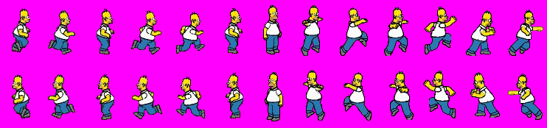
Sprite States
Running, Standing, Jumping, etc.
frame size = <57, 87>
Jumping sequence
Running sequence
Standing

Slide 28
Jumping - Sprite States
timeSinceLastFrame += gameTime.ElapsedGameTime.Milliseconds;
keystate = Keyboard.GetState();
if (keystate.IsKeyDown(Keys.Right))
{
homer.Y = 0;
if (homerpos.X < bkg.Width / 2 - 43)
homerpos.X += 3;
else
bkg.X += 3;
if (bkg.X >= panview.Width - bkg.Width)
homerpos.X += 3;
if (timeSinceLastFrame > millisecondsPerFrame)
{
homerIndex -= 1;
timeSinceLastFrame = 0;
if (homerIndex < 0)
homerIndex = 5;
}
}

Slide 29
Running - Sprite States
if (keystate.IsKeyDown(Keys.Left))
{
homer.Y = 87;
if (homerpos.X > bkg.Width / 2 + 43)
homerpos.X -= 3;
else
bkg.X -= 3;
if (bkg.X <= 0)
homerpos.X -= 3;
if (timeSinceLastFrame > millisecondsPerFrame)
{
homerIndex -= 1;
timeSinceLastFrame = 0;
if (homerIndex < 0)
homerIndex = 5;
}
}

Slide 30
Jumping - Sprite States
Jumping – Can we consider physics?
Move to the right sprite location (whether facing east or west)
Run through the sequences
How do you program for physics? [very important!]
In class discussion.

Slide 31
References
Some information and images are taken from the different online sources, only for educational purpose. I acknowledge them.

Slide 32
Thank you!

